Slide 1



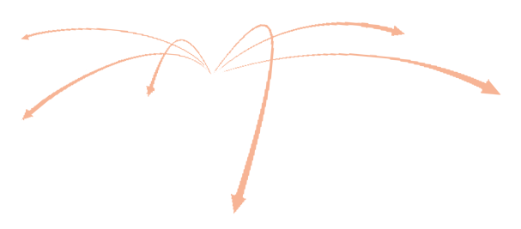


ZHONG HENG PET
APOLLO
PET PRODUCTS (CAMBODIA) CO,.LTD
Cambodia factory address
Address: Village 3, Commune 1, Preah Sihanouk District, Preah Sihanouk, Cambodia
<20 km from Sihanouk port
Sihanouk, Cambodia

Slide 2
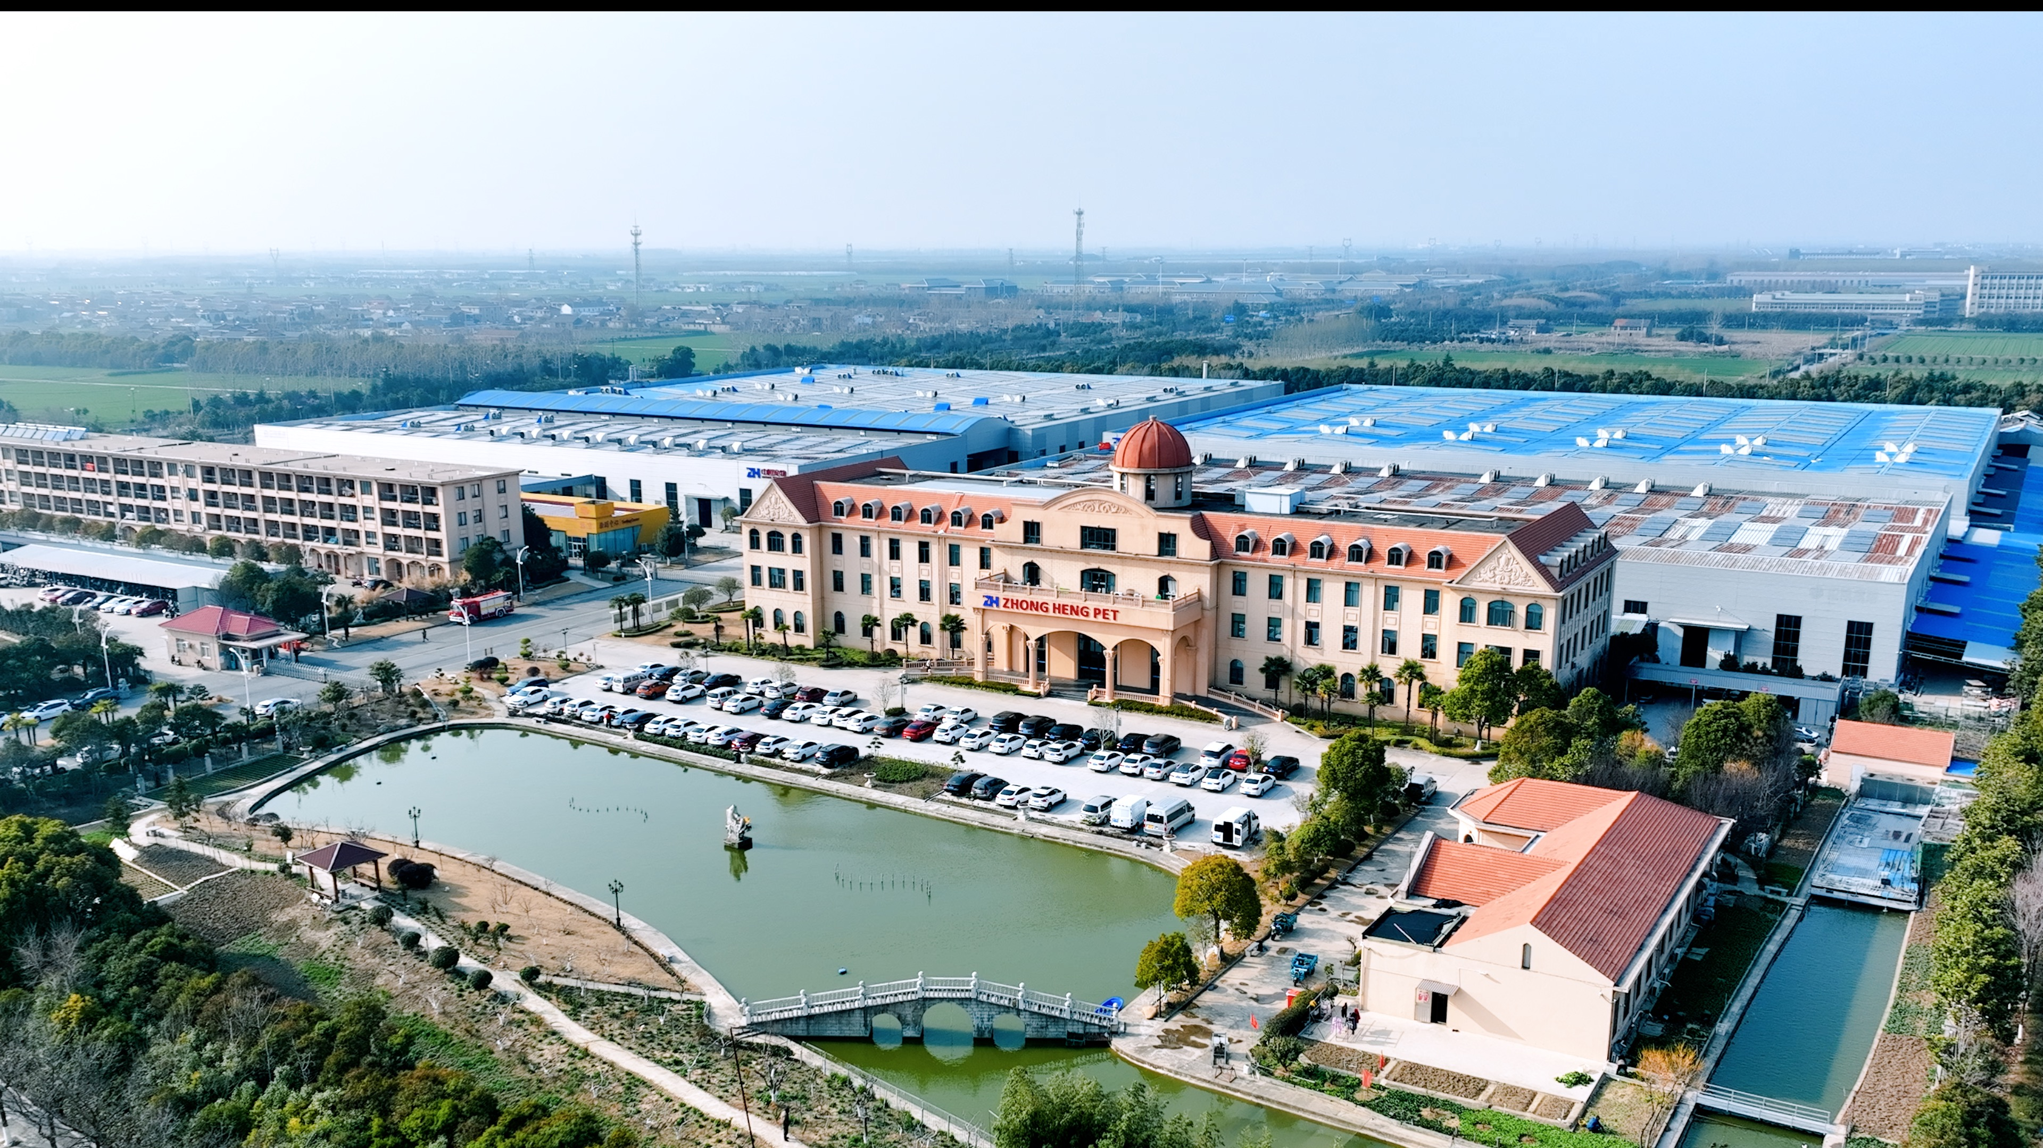
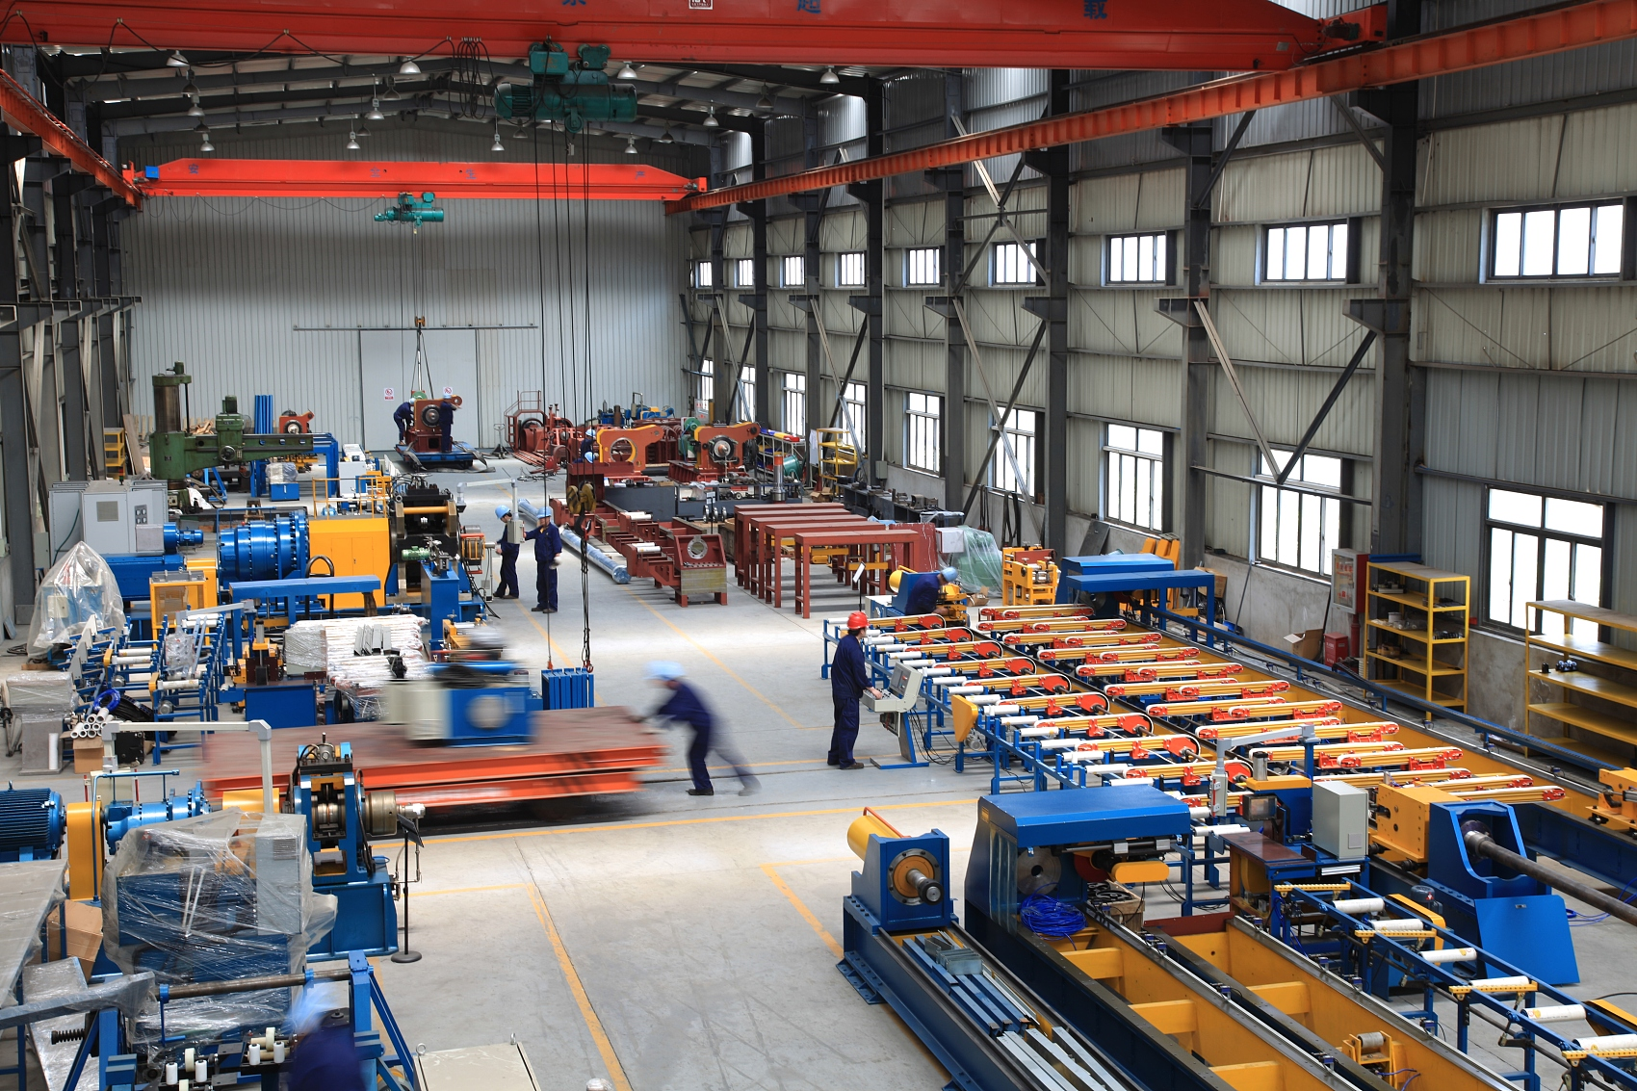
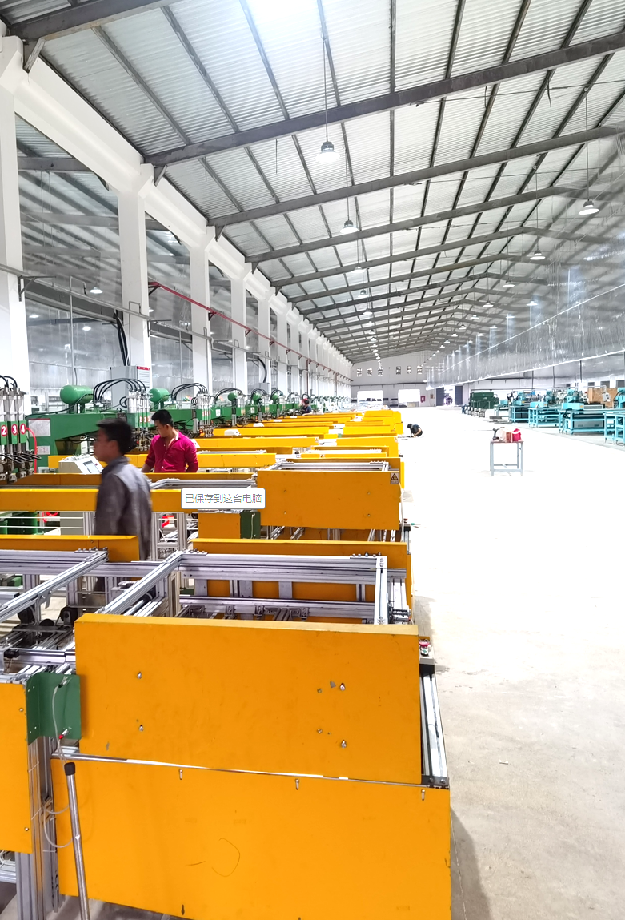

CONTENTS
COMPANY
PROFILE
FACTORY INTRODUCTION
PRODUCTIVE CAPACITY
PRODUCT
CATEGORY

Slide 3

APOLLO PET PRODUCTS (CAMBODIA) CO., LTD.
COMPANY PROFILE

Slide 4













Company Introduction
ZHONG HENG PET
APOLLO PET PRODUCTS(CAMBODIA) CO,.LTD is 100% owned by Zhongheng Pet Group.
Zhongheng was established in 2009 and specialized in the pet industry for many years. After years of steady development, ZH has grown in a comprehensive strength and has built several pet products categories plants in China and Cambodia, covering over 70 acres of land and having more than 2,000 global employees.
2,000+
Global Employee
2,000,000+ft²
Workshop area
500+
Patents Global
10000+
Product SKU
10+
Private brand
30+
Product Manager
50+
Designer
1000+
New Items Annually
300+
Cooperative partner
50+
Countries
30+
Quality control
50+
R&D Engineer
300+
Honorary Award

Slide 5
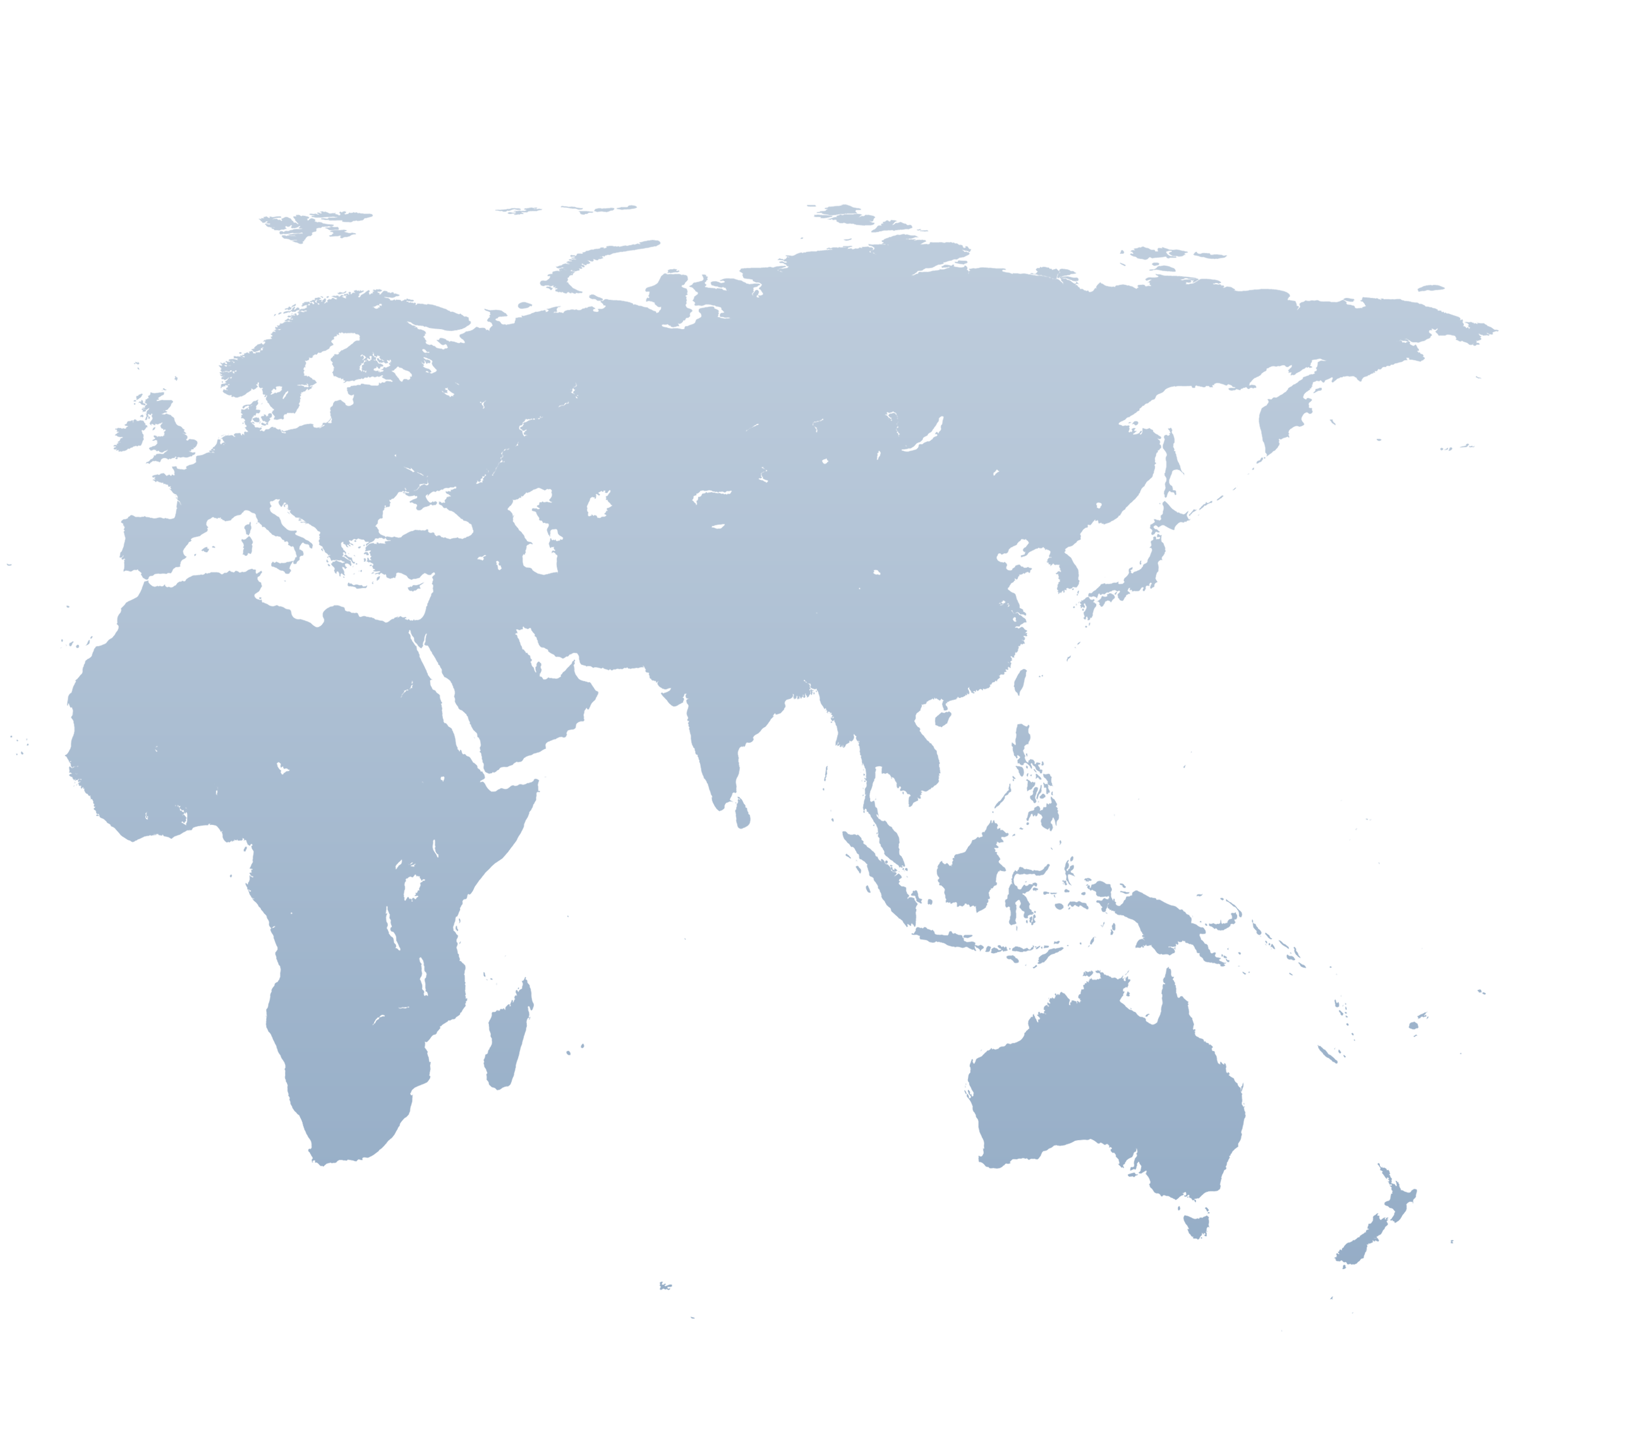

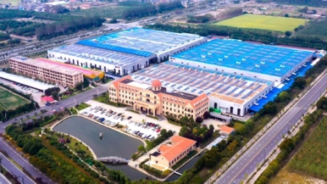

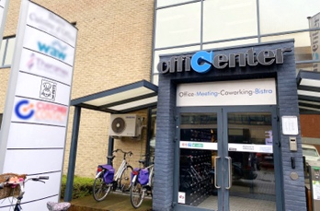

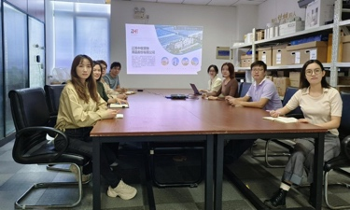


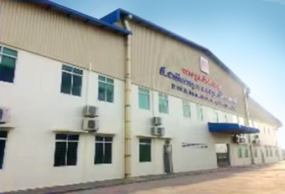
Global Strategy
ZHONG HENG PET
Global Layout
MPETS-Belgium ,European Market, 95 Partners
PWR-Cambodia, Pet Treats
APOLLO-Cambodia, Metal products,Waste bags,Cat Litter,Tie out cable,Plastic products
Warehouse service—USA, 50000 ft²
M-PETS Sales and Design Team
Located in Belgium
100% owned by ZHONGHENG
Founded in 2015
Have 95 partners , all over more than 40 countries in EU
Headquarter: ZHONGHENG PET
Include 3 factories, 6 workshops
Founded in 1994
Factory Area : 2,000,000 square ft
More than 2000 employees
Factories In China, Cambodia
Regional resources
Balance risks
SHANGHAI Design Team
Located in Shanghai, China
20+ designers
100% owned by ZHONGHENG
R&D Center
PWR
Full category design
More than 50 R&D and designers
Life cycle management from design to mass production
Located in Phnom Penh, CAMBODIA
100% owned by ZHONGHENG
Founded in 2015
300+ employees
APOLLO PET PRODUCTS (CAMBODIA) CO., LTD.
Located in Preah Sihanouk,CAMBODIA， < 10 km from port Sihanoukville
100% owned by ZHONGHENG
Founded in 2023
70+ employees, expected to reach 500+ employee after mass production

Slide 6
APOLLO PET PRODUCTS (CAMBODIA) CO., LTD.
FACTORY INTRODUCTION

Slide 7
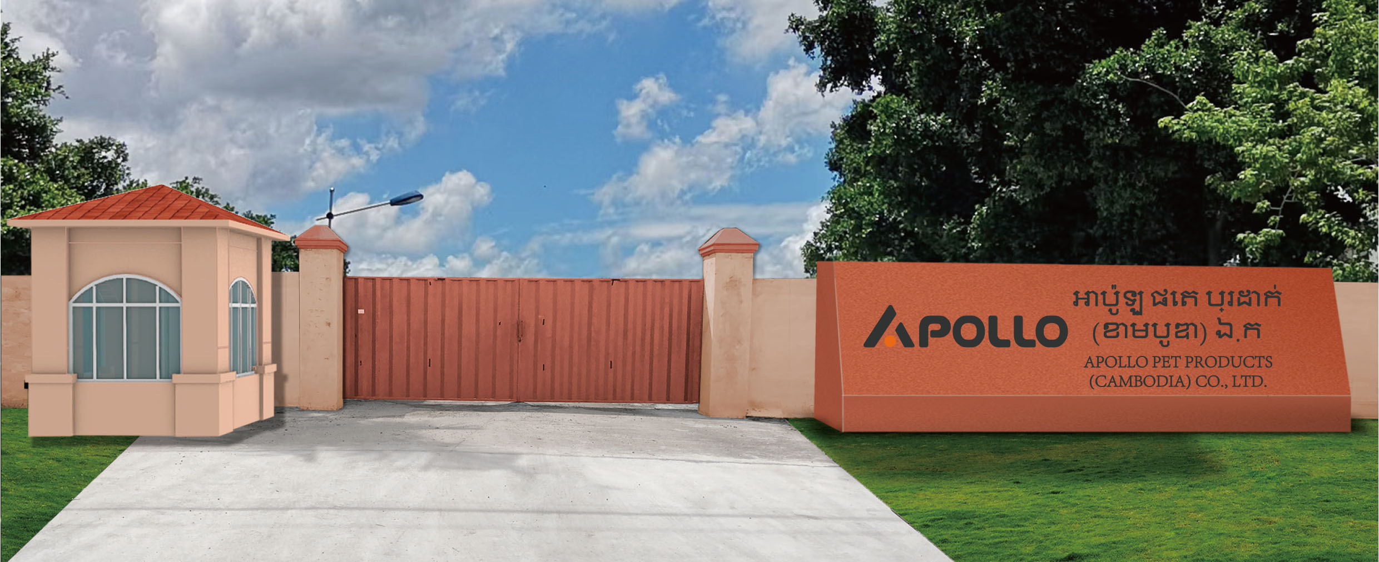




APOLLO PET PRODUCTS (CAMBODIA) CO., LTD.
70+ employees currently, expected to reach 500+ employee after mass production
200+automation equipment
Over 26k㎡ factory area
APOLLO PET PRODUCTS(CAMBODIA) CO,.LTD was founded in 2023 and is 100% owned by Zhongheng Pet Group. We can produce several pet catgroies like wire cages/ waste bags/ tie out cables and Toufu cat litter.
We are committed to becoming an innovative manufacturing center integrating R&D/manufacturing/warehousing and logistics, and providing high-quality pet products to our clients as always.

Slide 8





Apollo (Cambodia) Startup Timeline
工厂时间轴
Machineries Ready
Audit factory(BSCI)
First Shipment
  Mid September
  Early November
  Early September
  Mid October
  End December
Business License Ready
Production
Starts

Slide 9
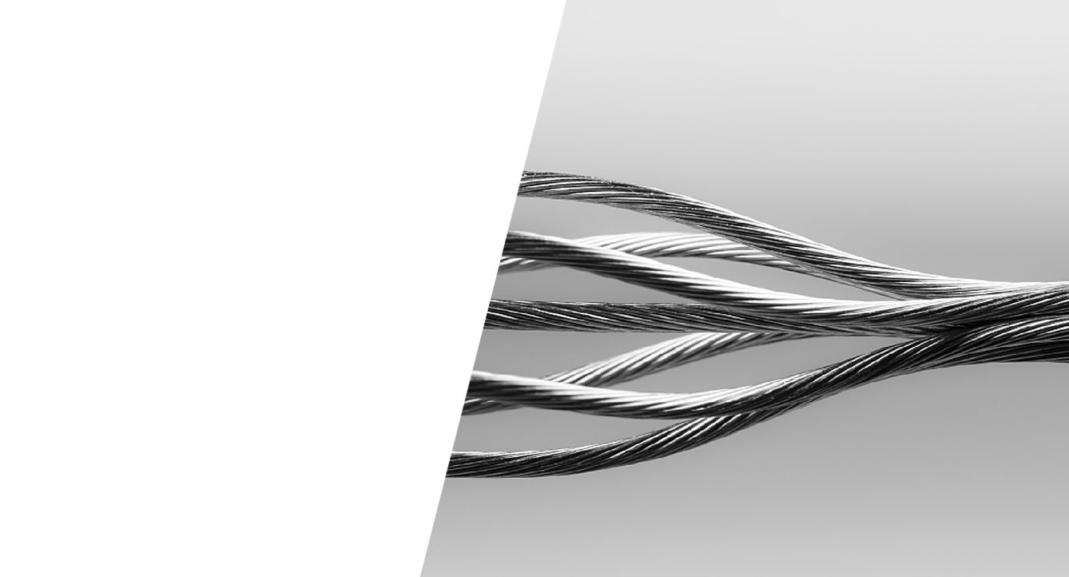

MISSION STRATEGY
使命目标
/ OUR MISSION
WE ARE COMMITTED TO PROVIDING CUSTOMERS WITH THE BEST QUALITY, COMPETITIVE PRODUCTS.
/APL的使命
致力于为客户提供最优质、有竞争力的产品
/ OUR STRATEGY
BECOME THE LEADER OF THE SUB-CATEGORY FACTORY
/ APL的战略目标
成为宠物细分品类工厂领跑者

Slide 10




Factory competitiveness
工厂竞争力
Systematic standard of product quality control
Efficient manufacturing skills and processes
Q
P
Automation equipment & continuous improvement
Flexible customization of production capacity
D
C

Slide 11
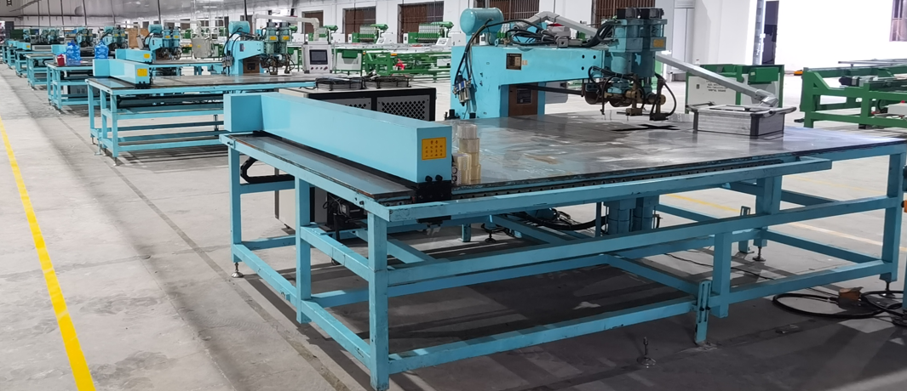
APOLLO PET PRODUCTS (CAMBODIA) CO., LTD.
PRODUCTIVE CAPACITY

Slide 12
STRONG PRODUCTION CAPACITY
强大的产能
 | Tie Out Cables | Waste Bags | Cat Litters | Training Pads | Metal Products | Sewing products
Machines | 10+ | 20+ | 2 lines | 2 set | Electrophoresis 1 line Spray Printing 1 line Automatic machine 100+ | 30+
Monthly Capacity | 150,000 pcs | 3,000,000 rolls | 1200 tons | 3,000,000 pcs | 300,000 pcs | 45,000 pcs
Products | Tie out cables, stakes, etc. | Poop bags, handle bags, cat litter bags, etc. | Tofu, corn, wheat, coconut, etc. | Puppy pads, training pads, etc | Folding wire cage, wire cage with sliding door, wire fence, ect. | Pet peds

Slide 13
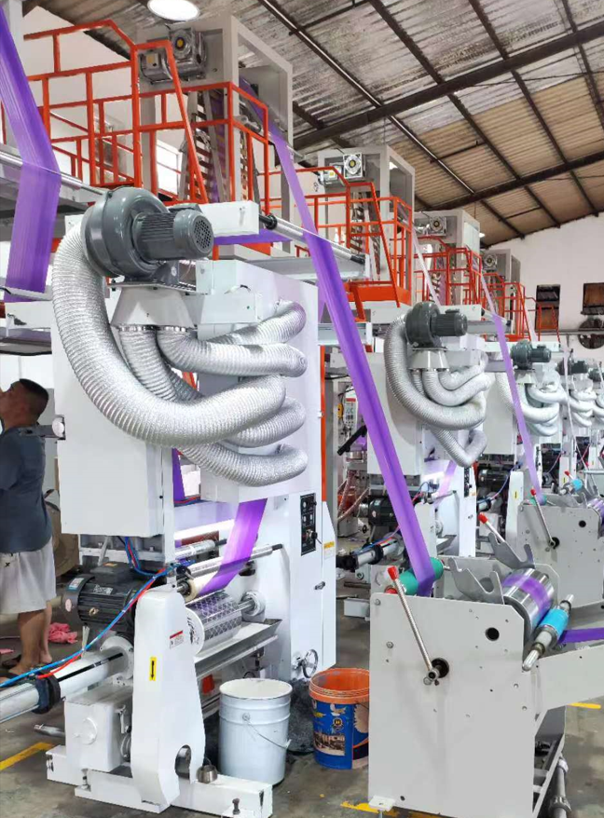
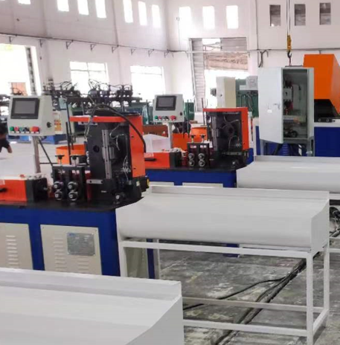
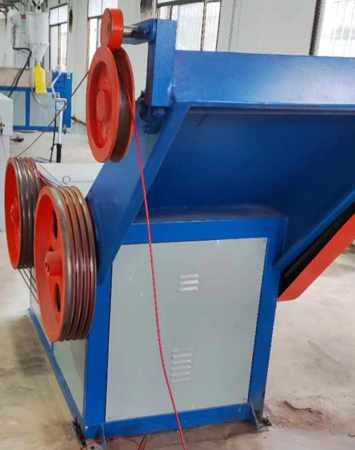
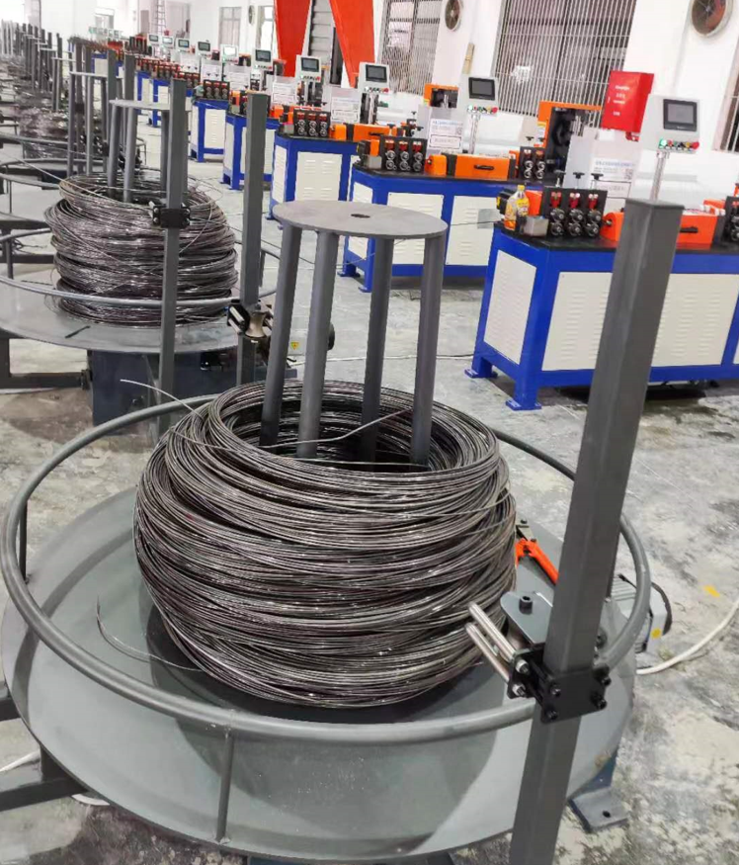
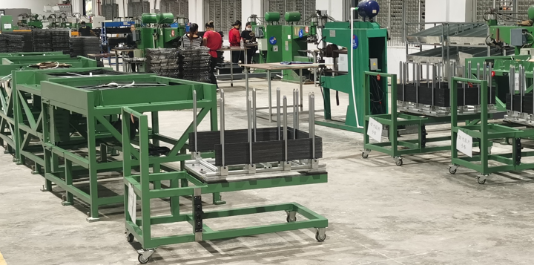
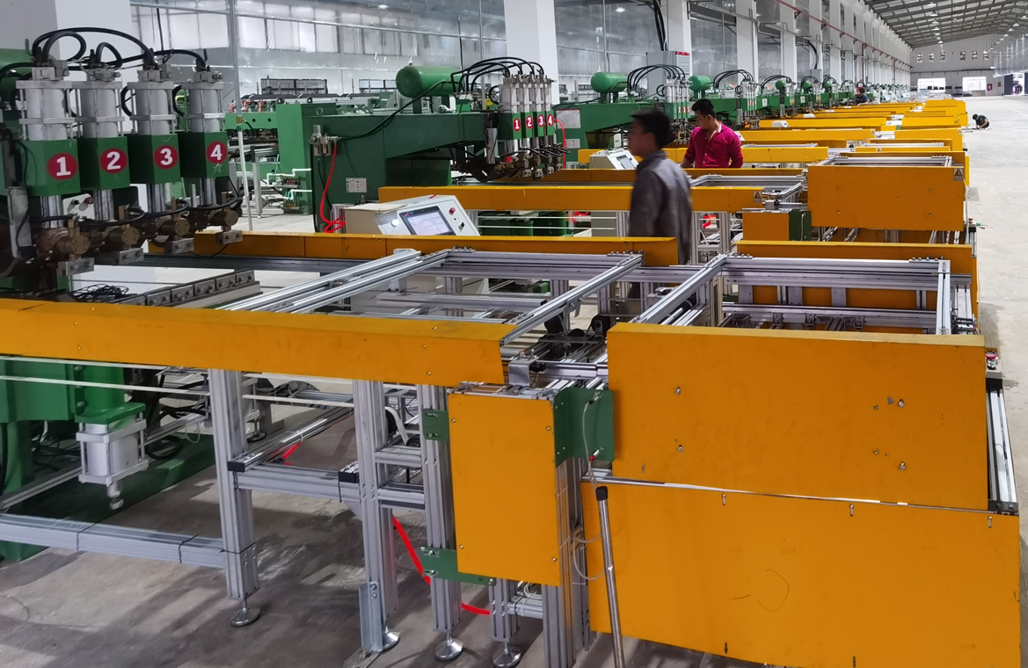
ADVANCED PRODUCTION EQUIPMENT
先进的生产设备
20+ Blowing & printing machines, high speed bag making machines & rolling machines
Automatic touch welding machine, open inclinable press, riveting machine, rope machine

Slide 14
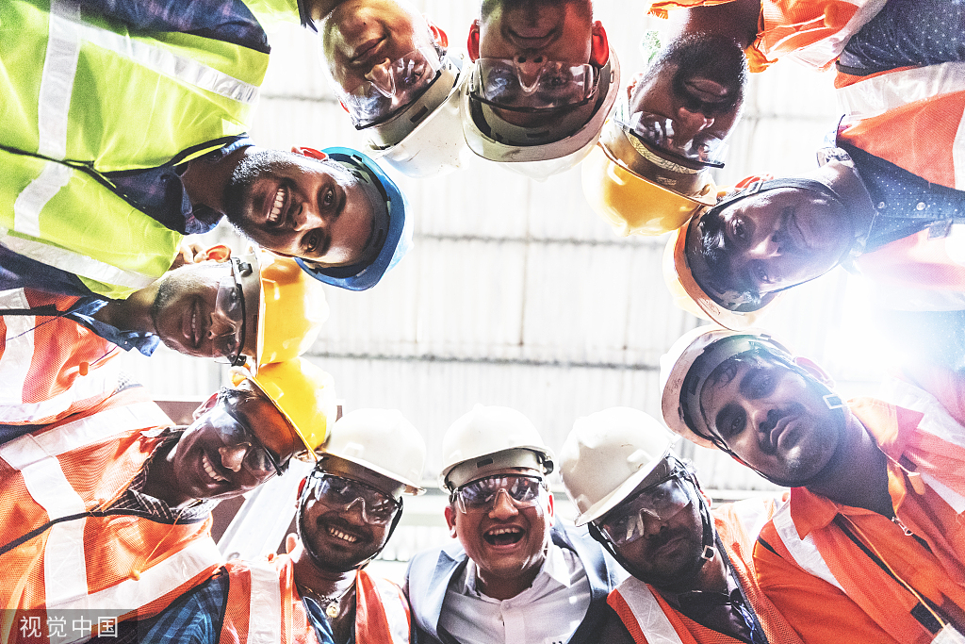
PROFESSIONAL PRODUCTION PERSONNEL
专业的生产人员
Full Time Workers: 70+ (expected to reach 500+ employee after mass production)
Research Engineers: 10+
QA/QC Staff: 15+

Slide 15
APOLLO PET PRODUCTS (CAMBODIA) CO., LTD.
PRODUCT
CATEGORY

Slide 16
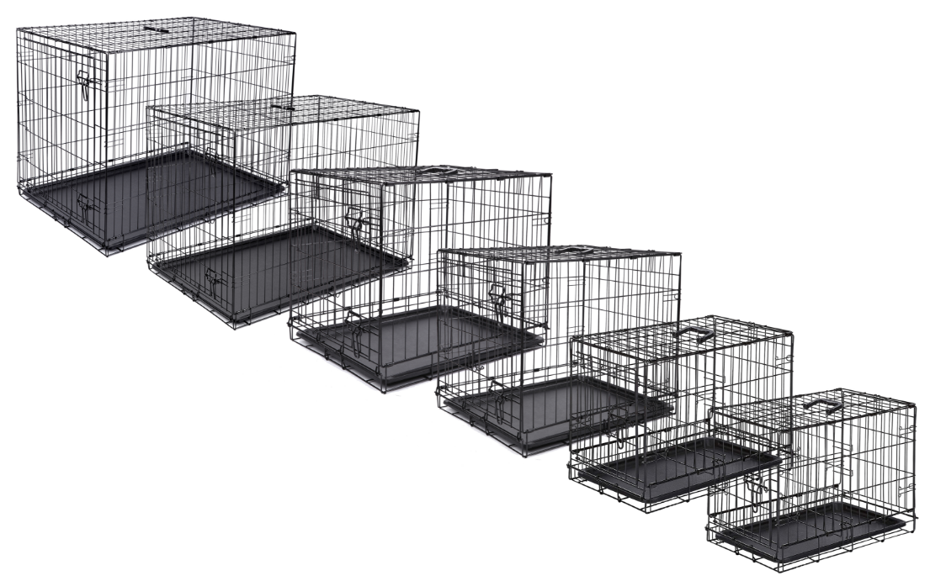
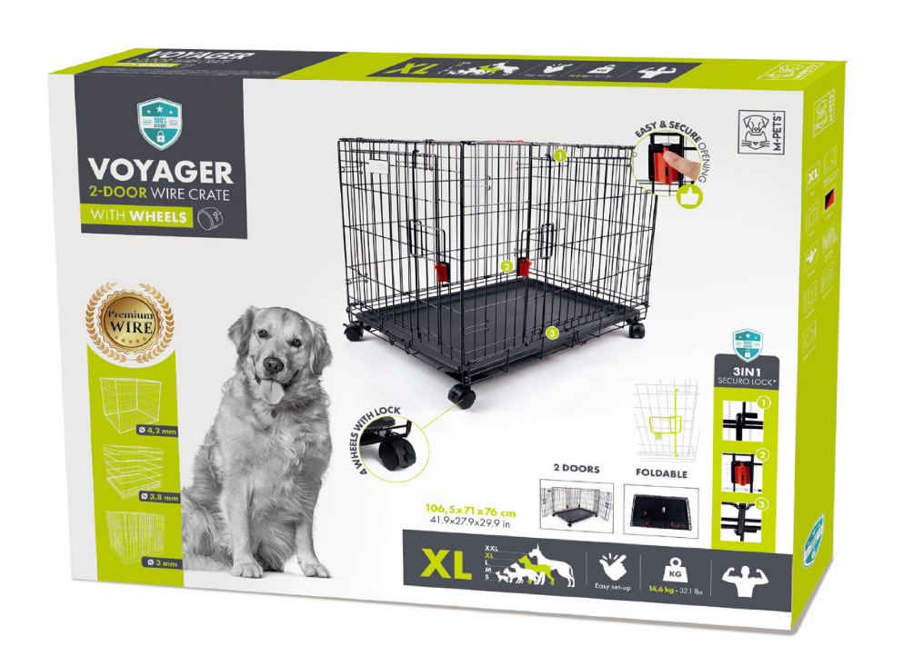
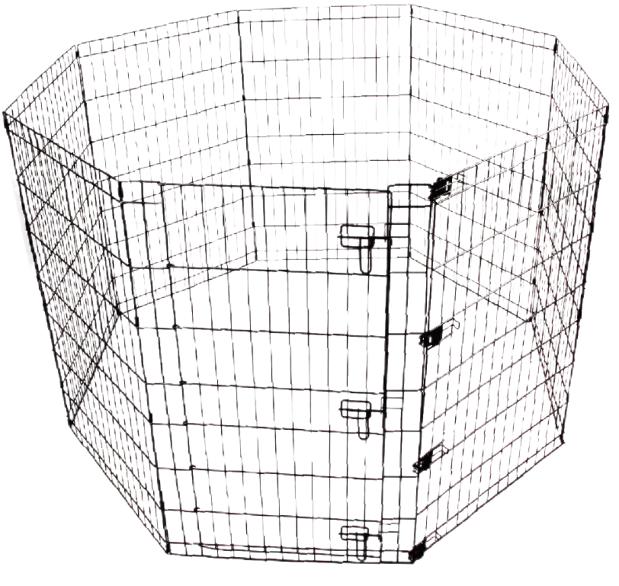

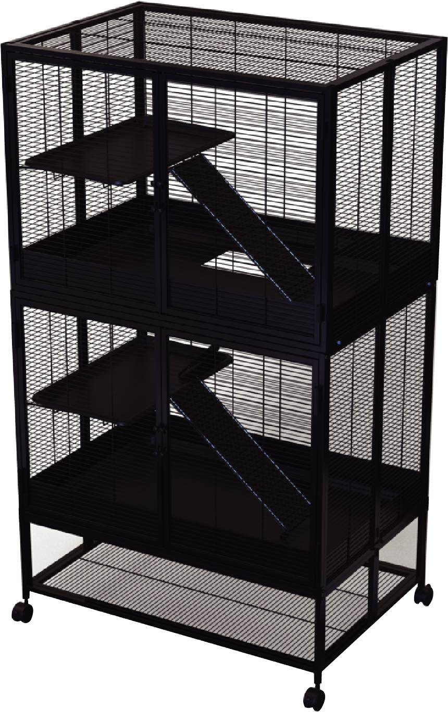
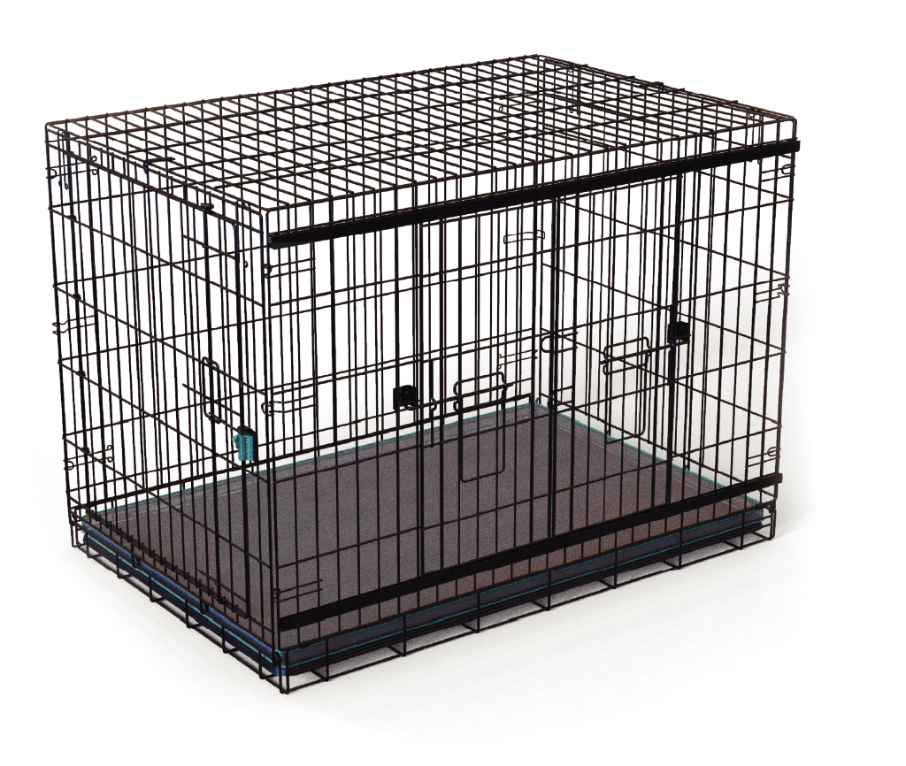
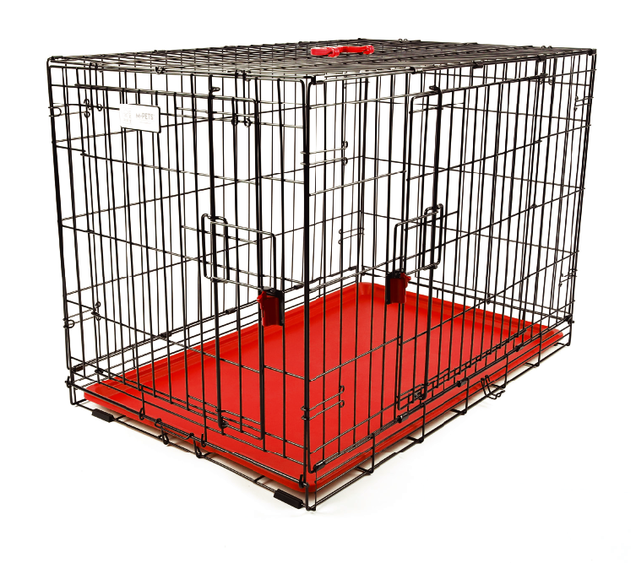
WIRE CRATES
铁丝笼
wire fence
车模产品
Multilayer cages
wire cages

Slide 17
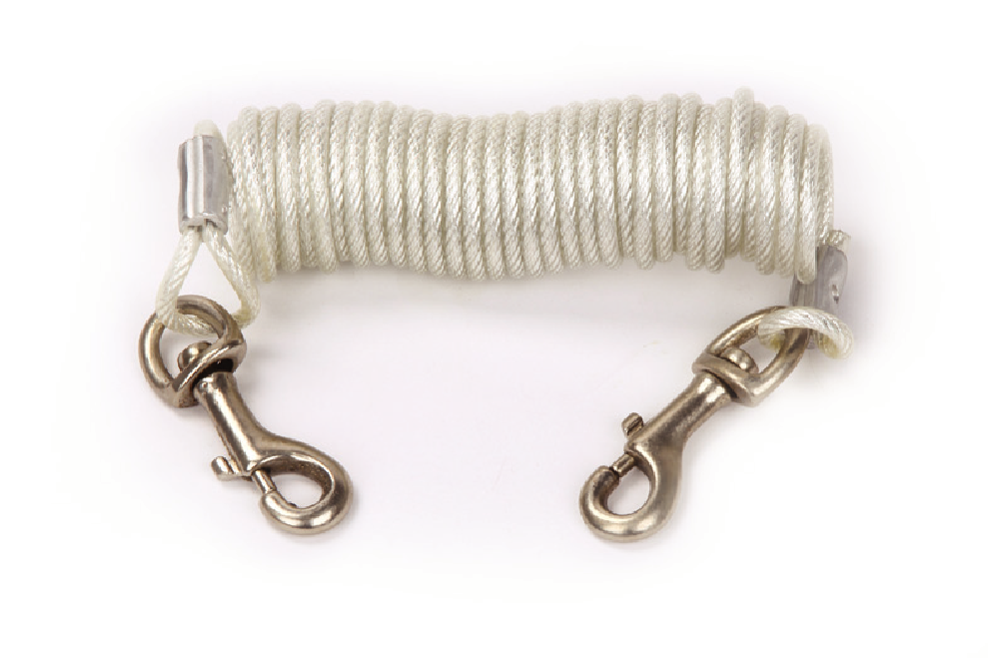
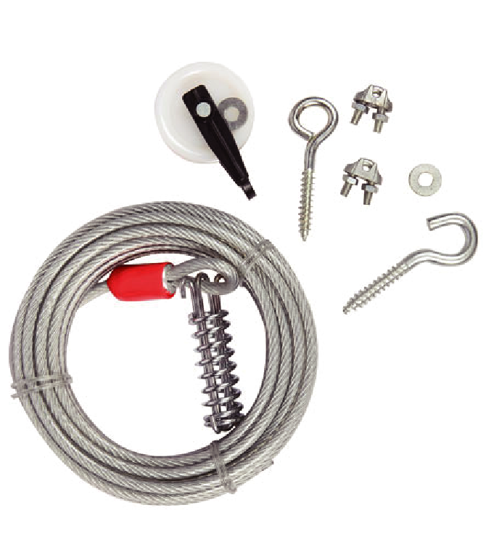
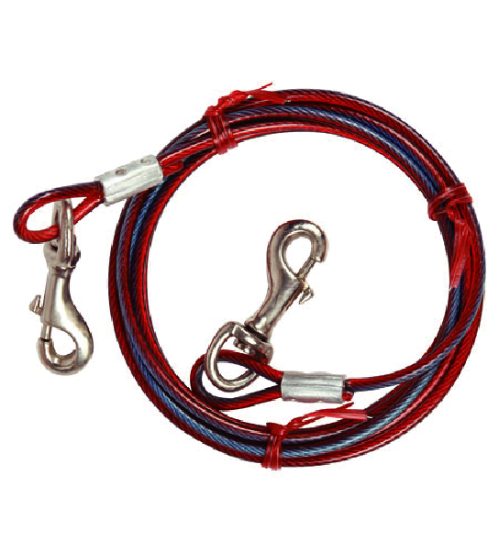
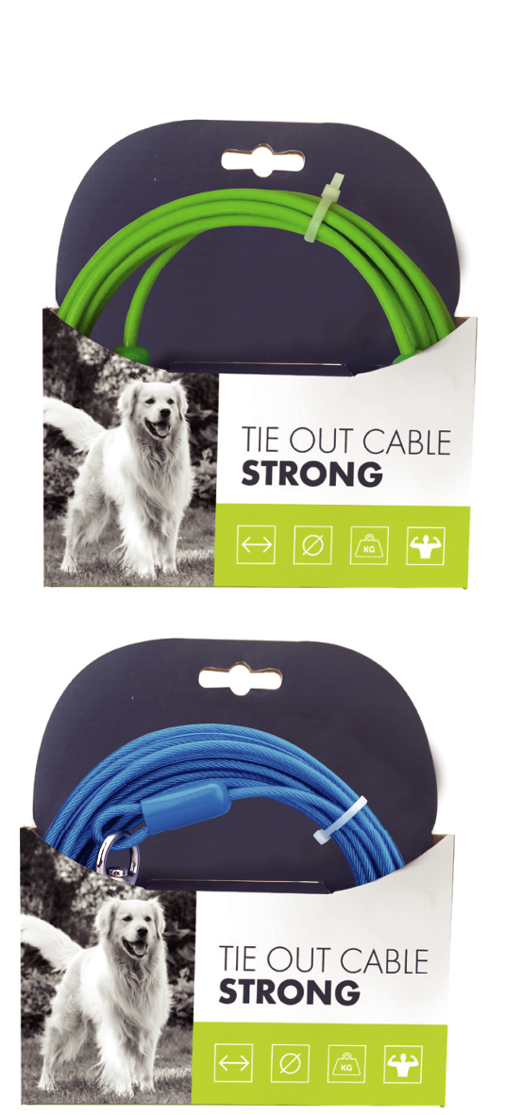
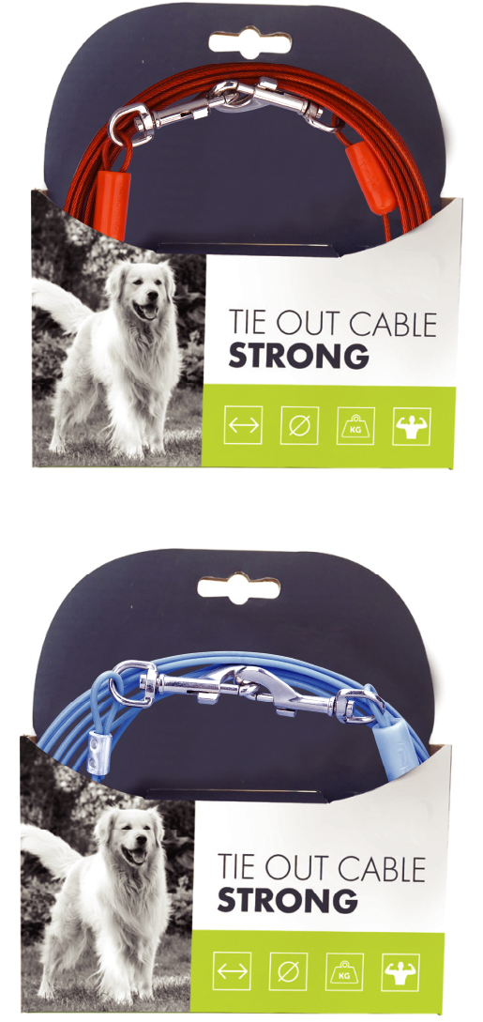
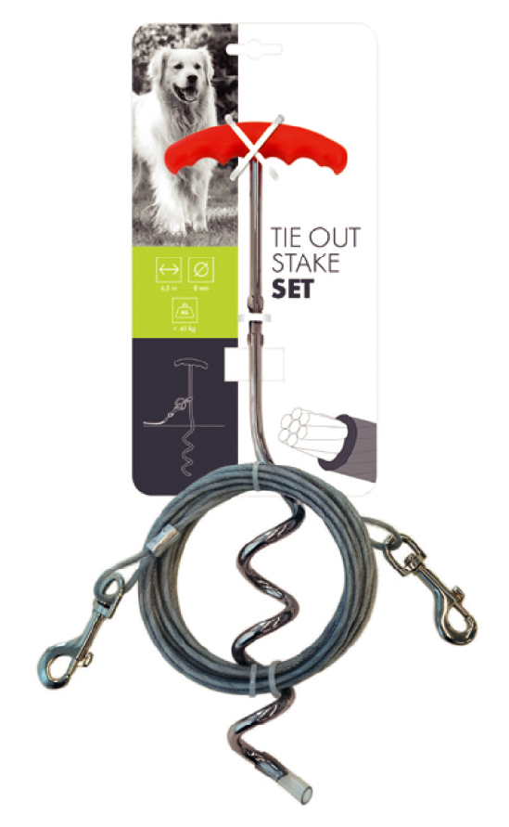
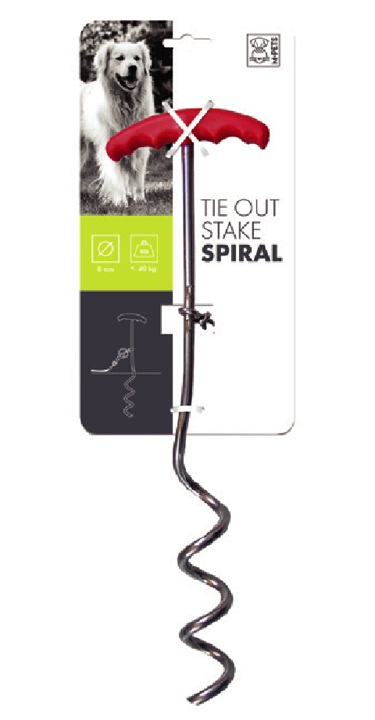
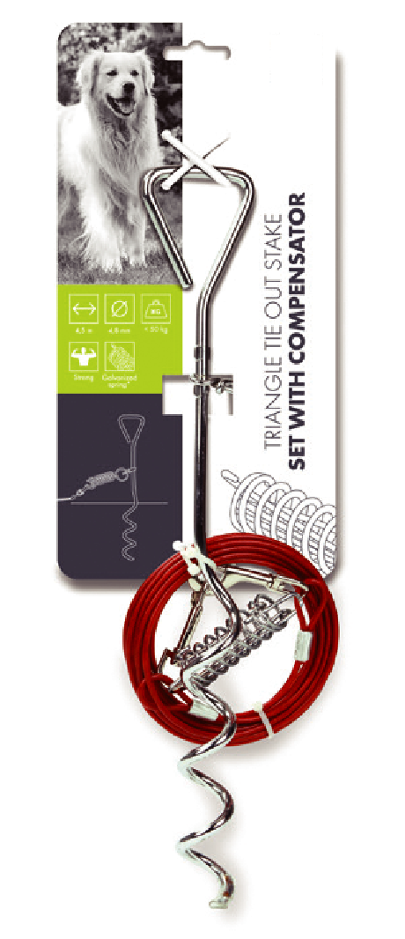
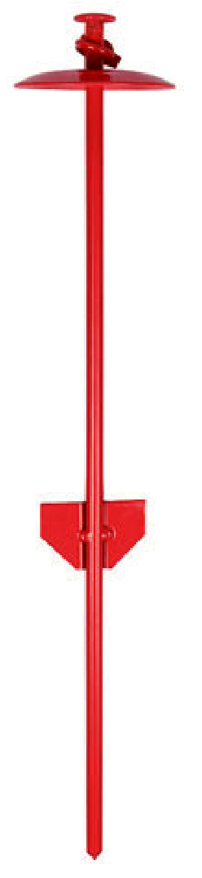
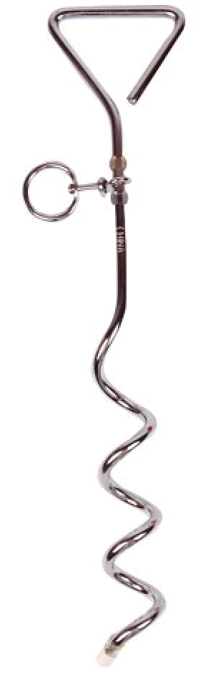
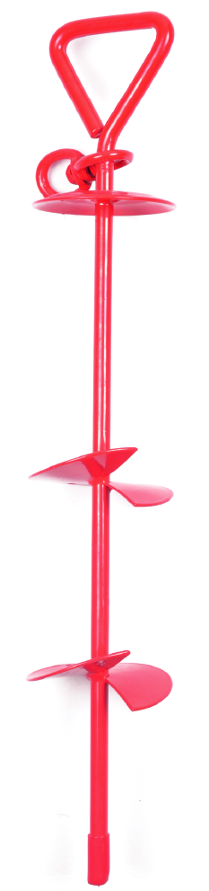
TIE OUT CABLES
钢丝绳
车模产品

Slide 18
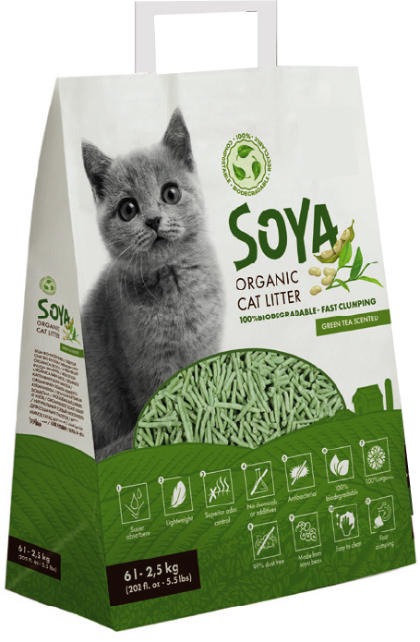
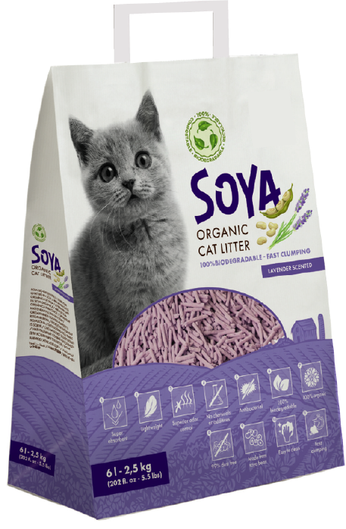
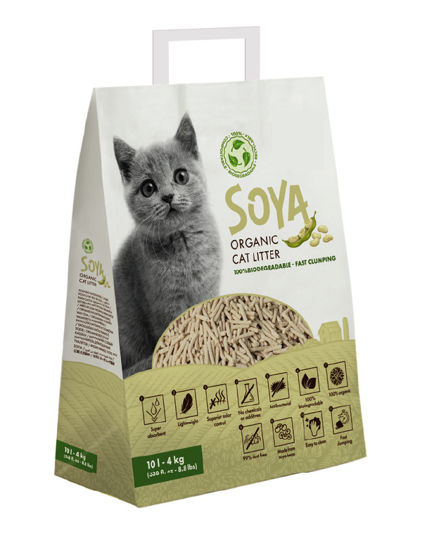
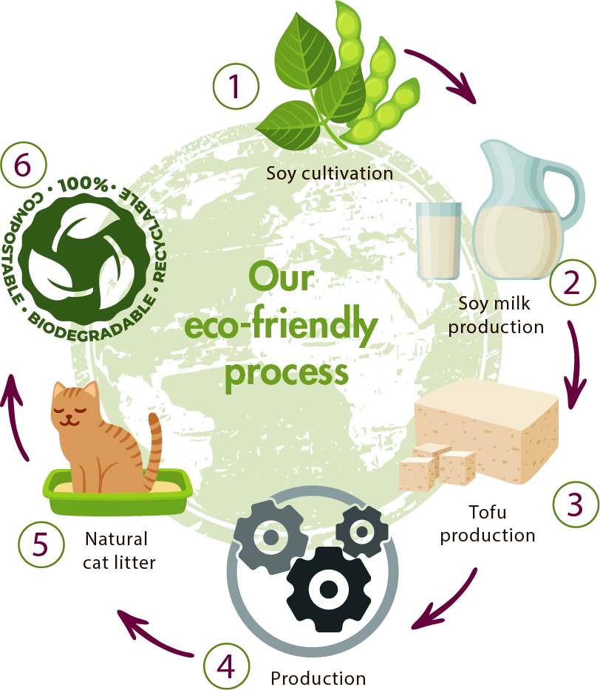

CAT LITTERS
猫砂

Slide 19
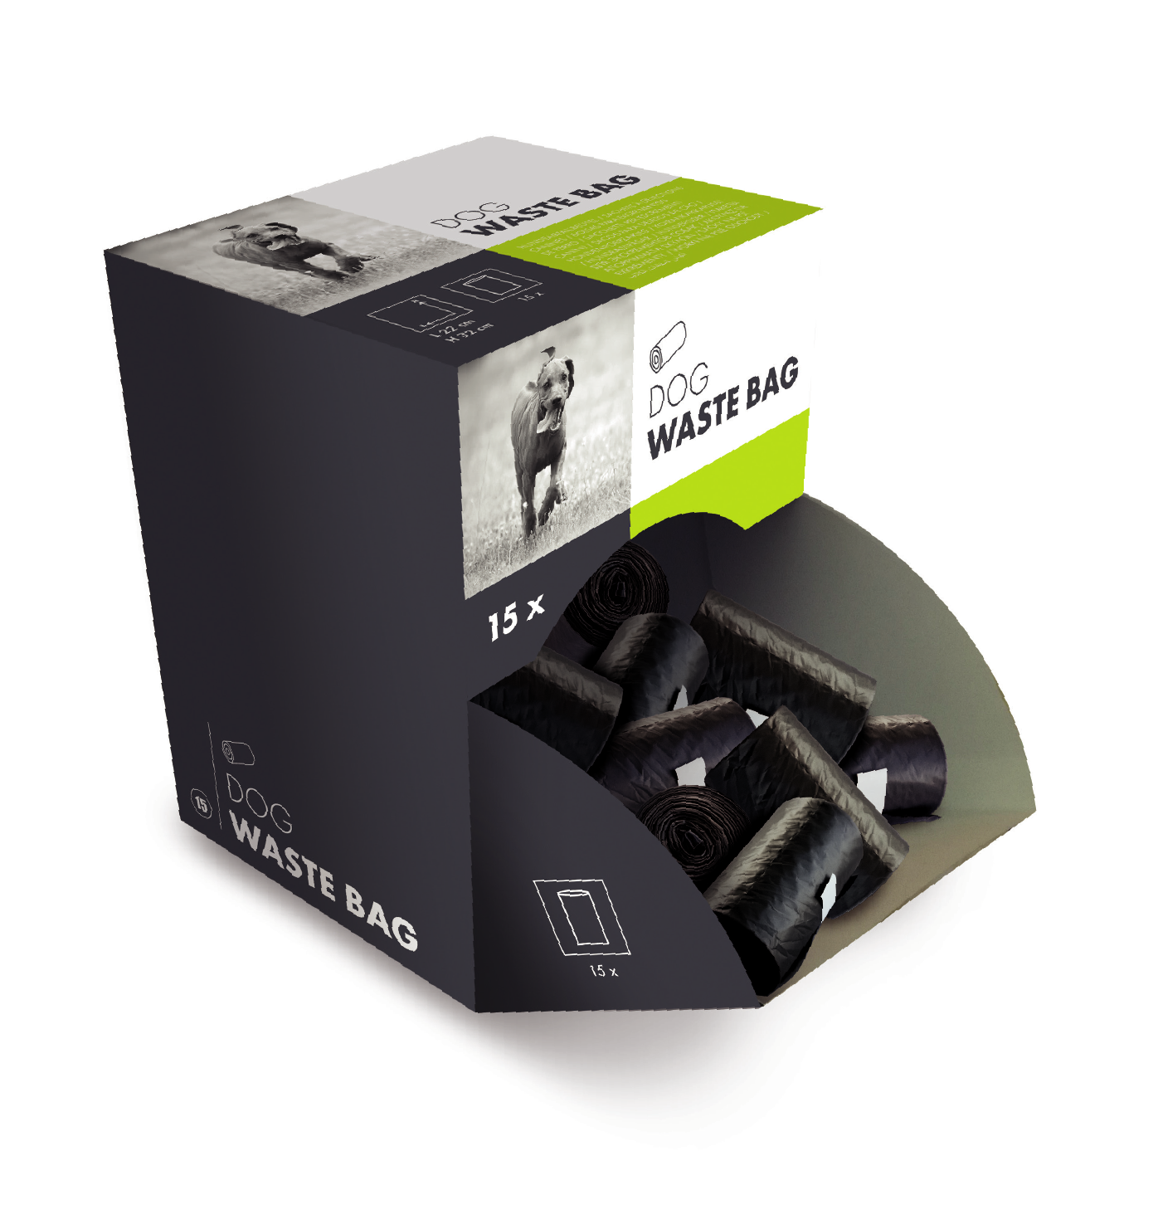
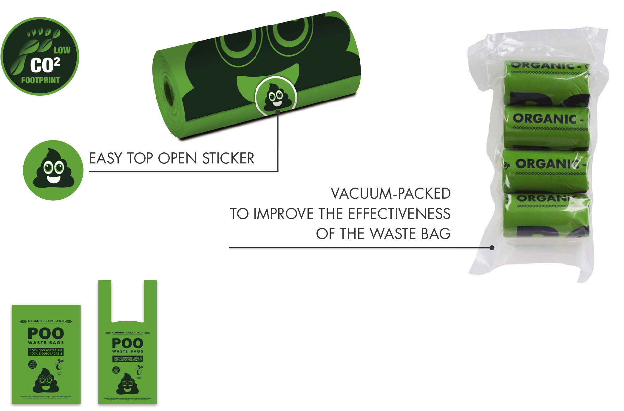
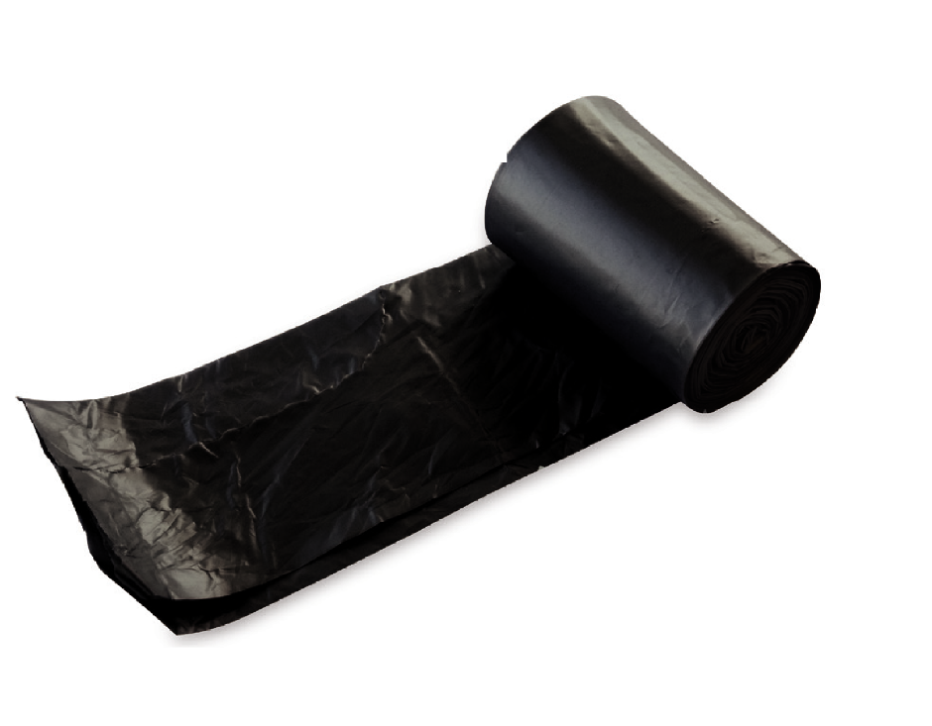

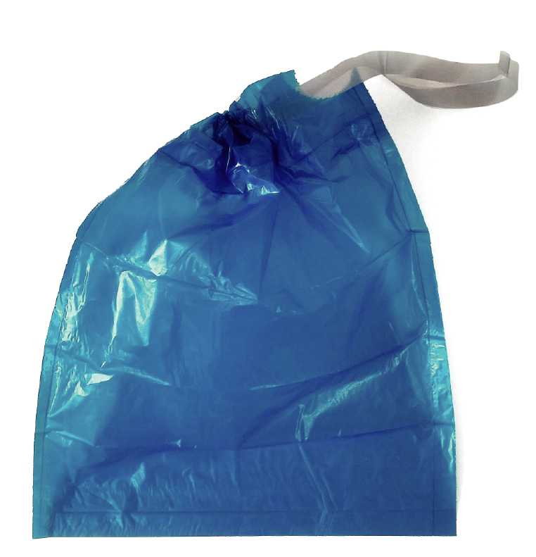

WASTE BAGS
垃圾袋

Slide 20
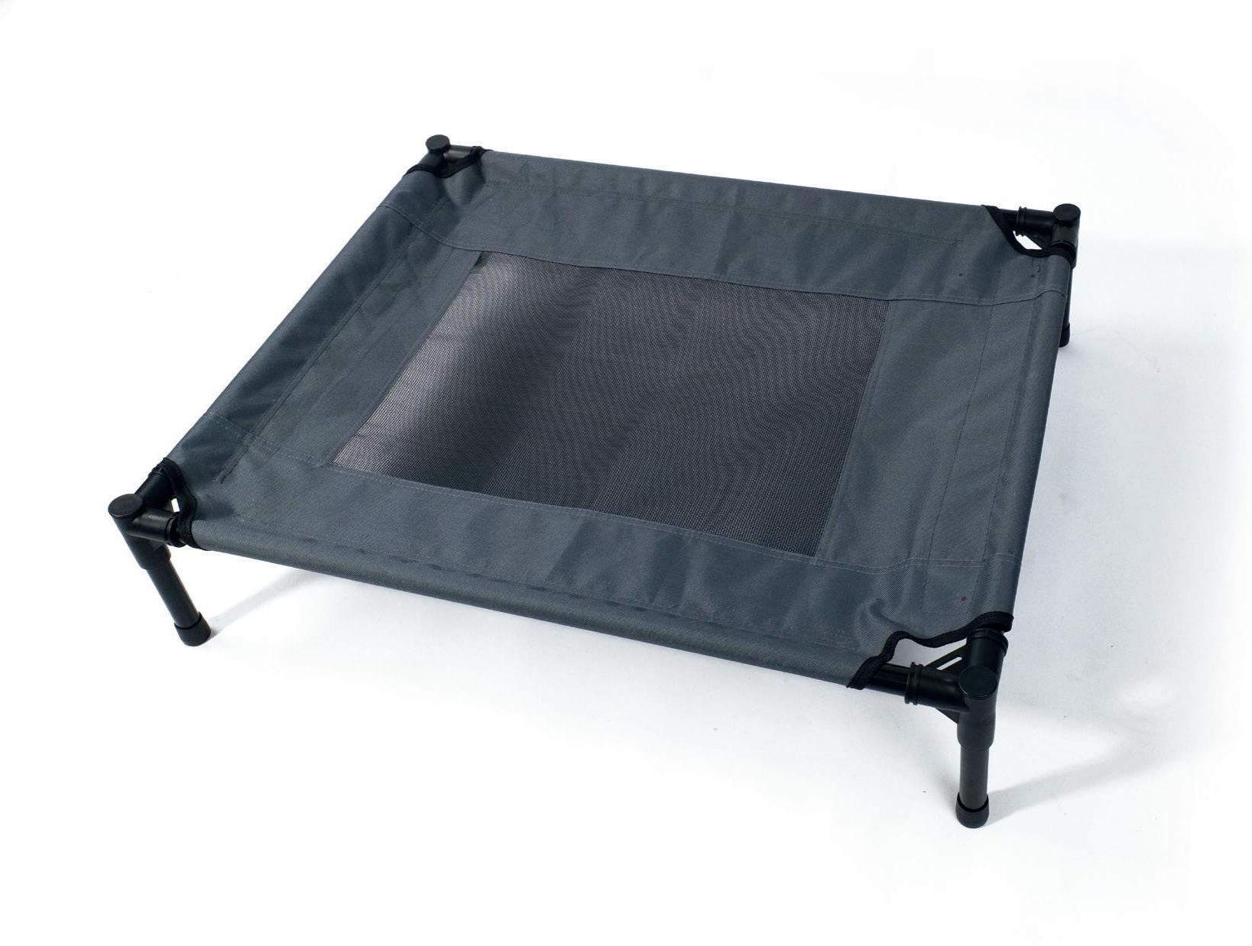
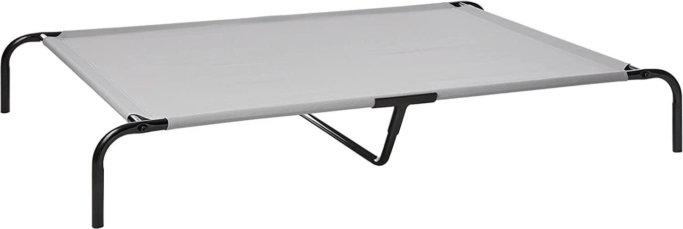
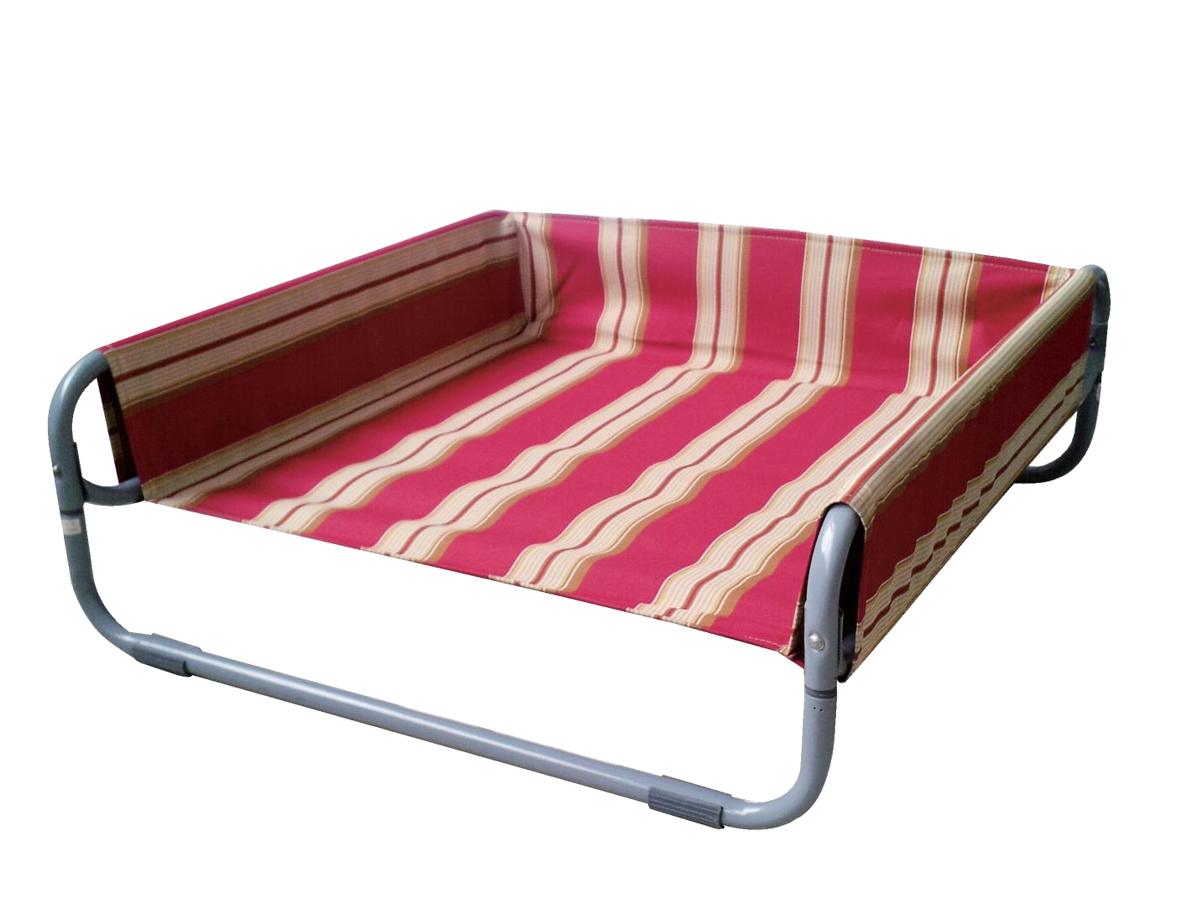
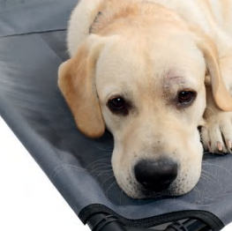
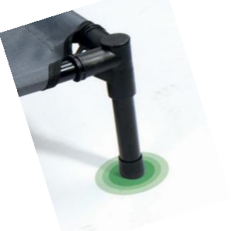
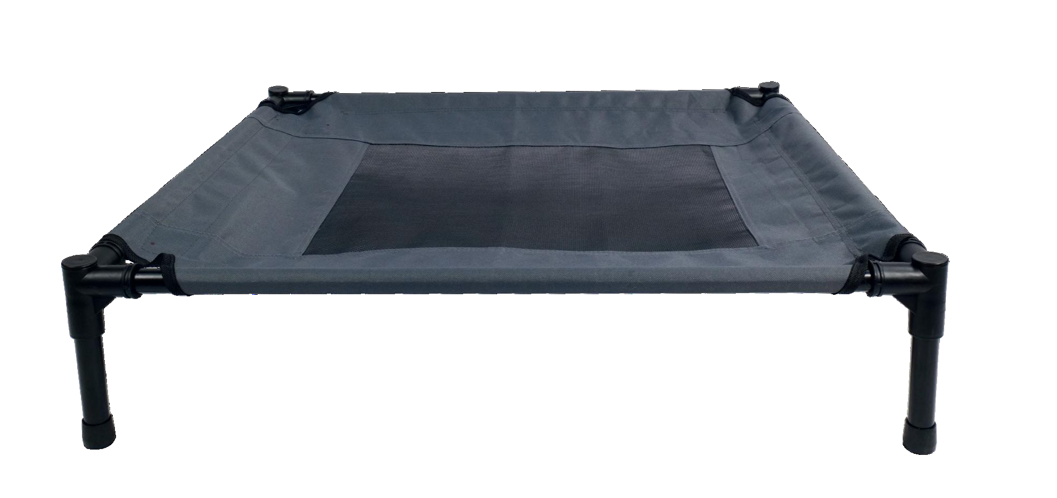





CUT & SEW
缝制
DURABLE DESIGN
ELEVATED COMFORT
INDOOR & OUTDOOR
ANTI-SLIP
AERATION
ELEVATED
COMFORT
ANTI-SLIP
ANTI-CORROSION
METAL FRAME

Slide 21






TRAINING PADS
尿垫
SCENTED TRAINING PADS
TRAVELLING & HOME PADS
Antibacterial
Leakproof
Fast drying
No odors
Clean paws
Herbs compositions

Slide 22









PLASTIC PRODUCTS
塑料件
Eco friendly srews,
no tool needed!
2 additional locks
for extra strength

Slide 23

LET'S BUILD A BETTER FUTURE FOR PETS TOGETHER！

